Slide 1

TOPIC RELATED TO RESTAURANT
MANAGEMENT

Slide 2
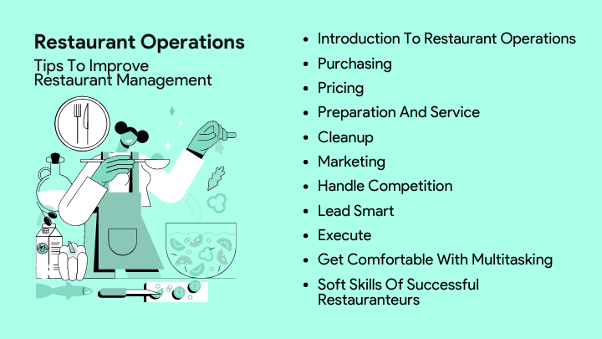
Introduction to Restaurant Management
Restaurant management involves overseeing the operations of a dining establishment.
It encompasses financial, operational, and human resource management.
Effective management is crucial for ensuring customer satisfaction and profitability.
Notes:
Image source: https://restaurantify.com/best-practices-for-restaurant-operations-and-efficient-restaurant-management/

Slide 3

Importance of Customer Service
Exceptional customer service can differentiate a restaurant from its competitors.
Training staff to provide attentive and friendly service enhances the dining experience.
Positive customer interactions can lead to repeat business and word-of-mouth referrals.
Notes:
Image source: https://vjcc.org.vn/doanh-nghiep/4-khu-vuc-quan-trong-doanh-nghiep-can-chuyen-doi-so.html

Slide 4

Staff Training and Development
Regular training ensures that staff members are knowledgeable about menu items and service standards.
Ongoing development programs can motivate employees and improve job satisfaction.
Investing in staff training reduces turnover rates and enhances team performance.
Notes:
Image source: https://ar.inspiredpencil.com/pictures-2023/staff-training-and-development

Slide 5
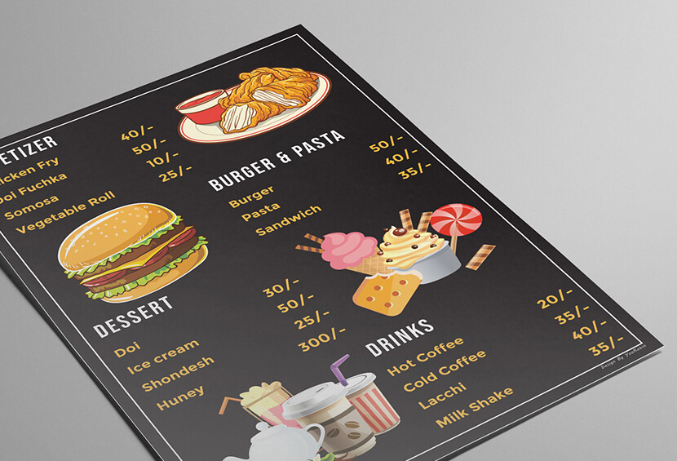
Menu Design and Engineering
A well-designed menu can influence customers’ choices and increase sales.
Menu engineering involves analyzing the profitability and popularity of each item.
Seasonal and local ingredients can enhance the menu’s appeal and freshness.
Notes:
Image source: https://graphicmama.com/blog/creative-modern-menu-designs/

Slide 6
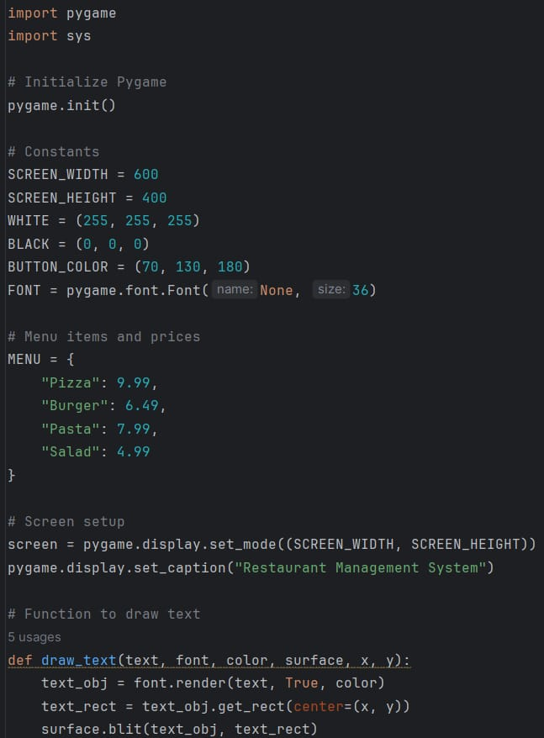
CODE

Slide 7
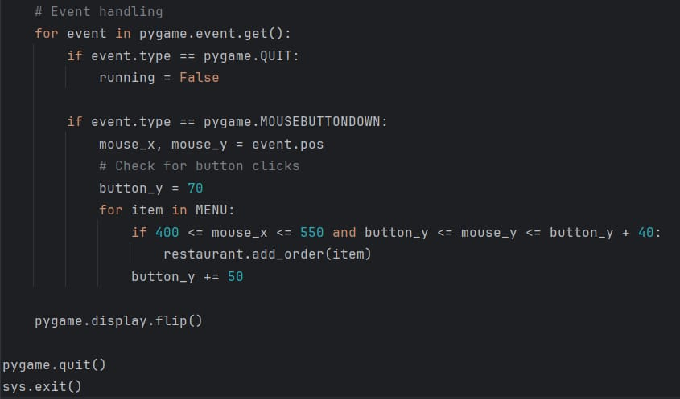

Slide 8


Slide 9
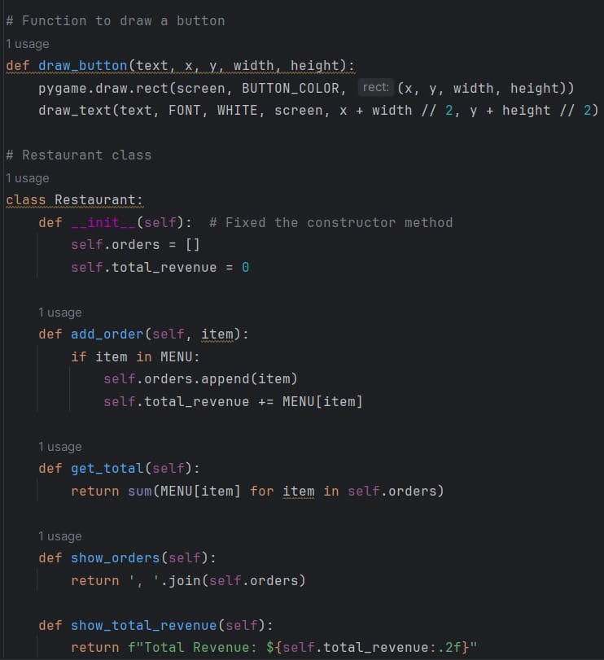

Slide 10
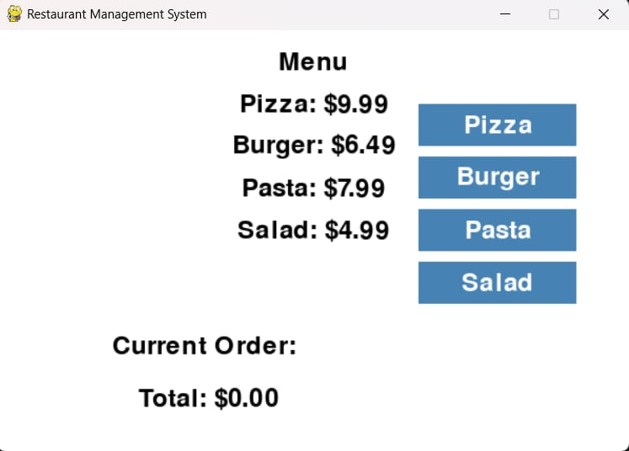

Slide 11
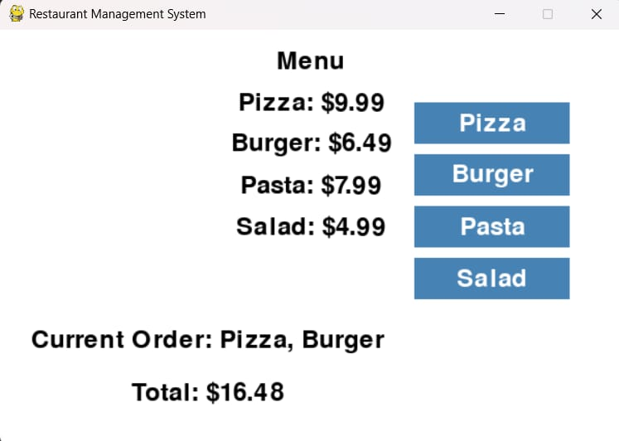

Slide 12
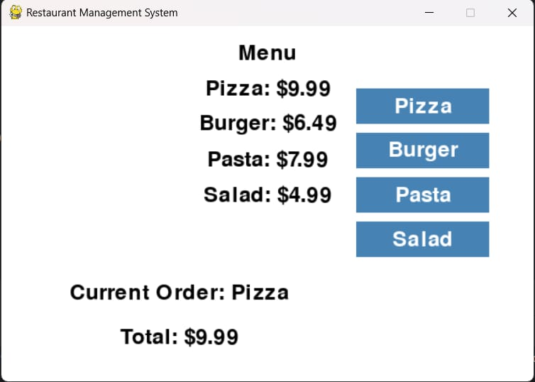

Slide 13

Conclusion and Future Trends
Successful restaurant management requires adaptability to changing market trends.
Sustainability practices are becoming increasingly important to consumers.
Embracing innovation will be key to staying competitive in the restaurant industry.
This presentation covers various aspects of effective restaurant management that are essential for success in the industry.
Notes:
Image source: https://maddalenawcordi.pages.dev/whpddq-restaurant-food-trends-for-2024-qzwqzysmr-photos/

Slide 14



